Slide 1
Survey Research

Slide 2
Surveys
Can be measured quantitatively and qualitatively
2 characteristics
Measured using self-report questions
Pay attention to how you sample your participants
Population
Entire group of people in a given area/domain
Sample
A subset of people from a population

Slide 3
Contents of Surveys
Surveys vary!
Long or short
In person, printed/mailed, telephone survey, online
Wide range of topics
Motivation, emotion, personality, politics, behavior
Most survey research is non-experimental
Still able to run experiments, however.
Positive Newspaper article
Survey
Negative Newspaper article

Slide 4
Brief History of Surveys
Governmental programs (measure poverty)
Eventually (30’s) measuring a wide array of social/economic conditions
Marketing companies / industry researchers began studying consumer preferences
Political campaigns / pollsters began using research for political elections.

Slide 5
Important for….
Industry market research
politics
Academia
Medicine!

Slide 6
Survey Construction
Question Interpretation
Judgment Formation
Response Editing
Information Retrieval
Response Formatting
“How many alcoholic drinks do you consume in a typical day?”
A lot more than average
Somewhat more than average
Average
Somewhat fewer than average
A lot fewer than average

Slide 7
Survey Construction
Open-ended items
Ask a question and give participants the option to answer the question in whatever way they choose.
“Tell us about your depression over the last month”
Closed-ended items
Ask a question and provide a list of options for the participant to choose from
“How tall are you”: A) < 5’2’’ B) 5’2’’ – 5’8’’ C) > 5’8’’
Different types of rating scales
1 2 3 4
Strongly Disagree Slightly Disagree Slightly Agree Strongly Agree
0 50 100
Enter a number between 0 and 100: _________________

Slide 8
BRUSO (Peterson, 2000)
Brief
Relevant
Unambiguous
Specific
Objective

Slide 9
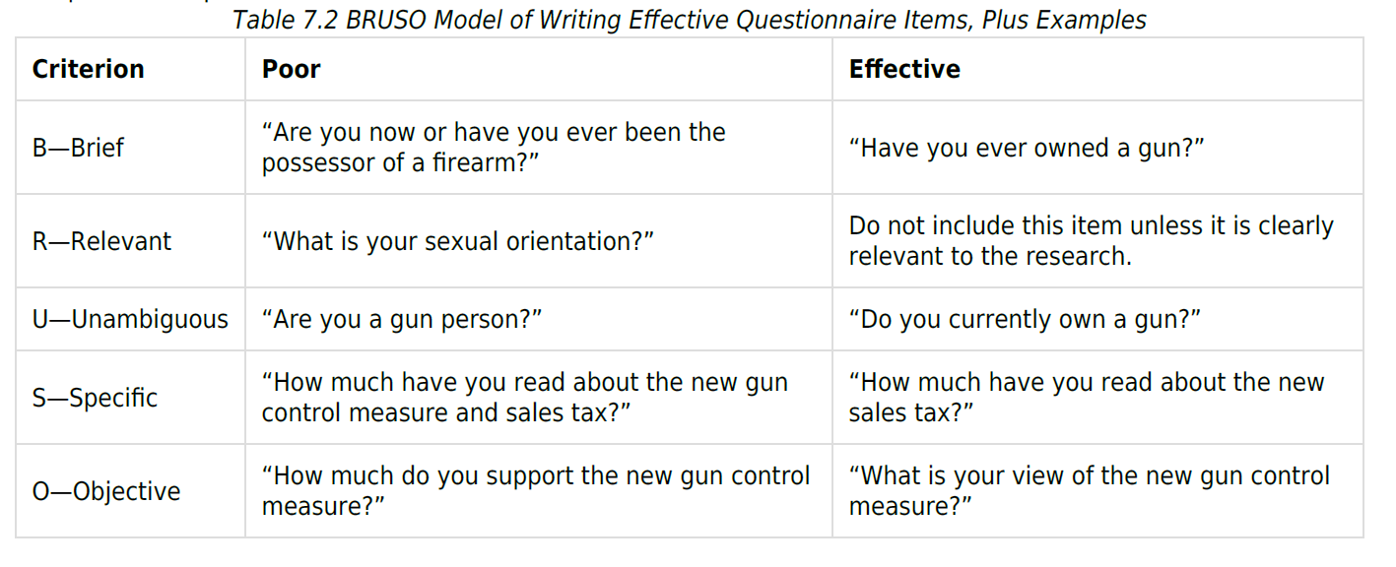
BRUSO (Peterson, 2000)

